Slide 1
Redefine Gentrification
Team 5:
Brian Chang
Prakruti Gohel
Hector Fonseca

Slide 2
Definition of Gentrification
A process in which a poor area (as of a city) experiences an influx of middle-class or wealthy people who renovate and rebuild homes and businesses and which often results in an increase in property values and the displacement of earlier, usually poorer residents
Notes:
The U.S. Census Bureau releases census-tract-level data for the entire U.S. classifying these towns as gentrified, gentrification zones and opportunity zones. To invest in a gentrification zone or opportunity zone your town would have to be in the 40th percentile for median home value and household income. This data has drawn the attention of big real estate investors as a means of not having to pay capital gains tax. Also, these zones are not part of federal revitalization programs so they hold no restrictions or government qualifications nor is there a limit of how much an investor can invest. This in turn means there is no limit on the amount of capital gains deferred and forgiven.

Slide 3
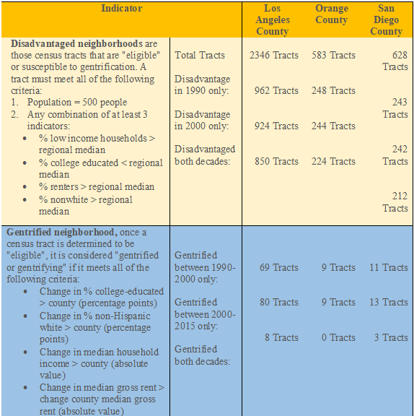
Criteria Used to Evaluate Gentrification
Notes:
Five factors that are examined for an area to be susceptible to gentrification:
Which communities are most at risk from job displacement in the hospitality, retail, personal care, and service sectors.
Which communities are at risk due to a disproportionate high percentage of residents not enrolled in Unemployment Insurance benefits
Which communities have high numbers of renter households that are experiencing extreme financial hardships
Which communities are most burdened by shelter-in-place mandates
Which communities are likely to be unrepresented in the census due to low response rates

Slide 4
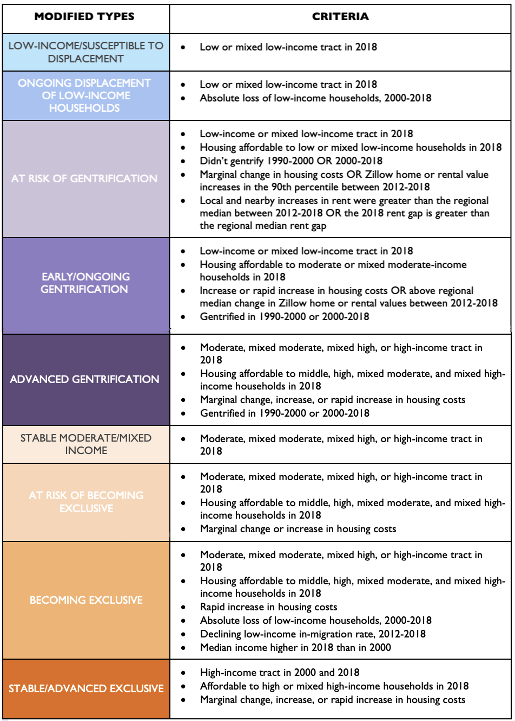
Types of Gentrification
Notes:
In 2018 Los Angeles exhibited the highest rates of gentrification, with 10% of areas classified as At Risk of Gentrification, Early/Ongoing Gentrification, or Advanced Gentrification. In addition, 5% of areas were not gentrifying but experienced Ongoing Displacement of Low-Income Households.
Nearly half of all Atlanta neighborhoods experienced a rapid increase in housing costs between 2000 and 2017. 22% of lower-income neighborhoods in Atlanta were at risk of gentrification in 2017, and 7% were undergoing displacement of low-income households without gentrification.
Almost 8% of low-income households in the metro region are living in moderate to high income neighborhoods that are experiencing advanced stages or super gentrification.

Slide 5
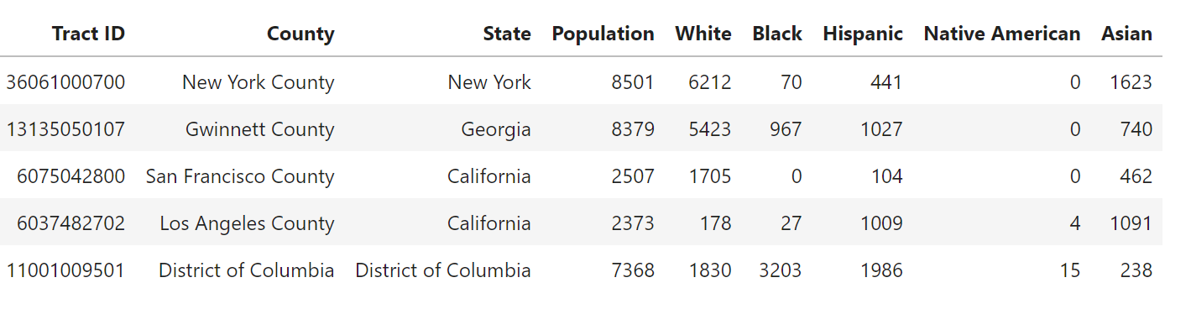
Sample Population of Given Cities

Slide 6
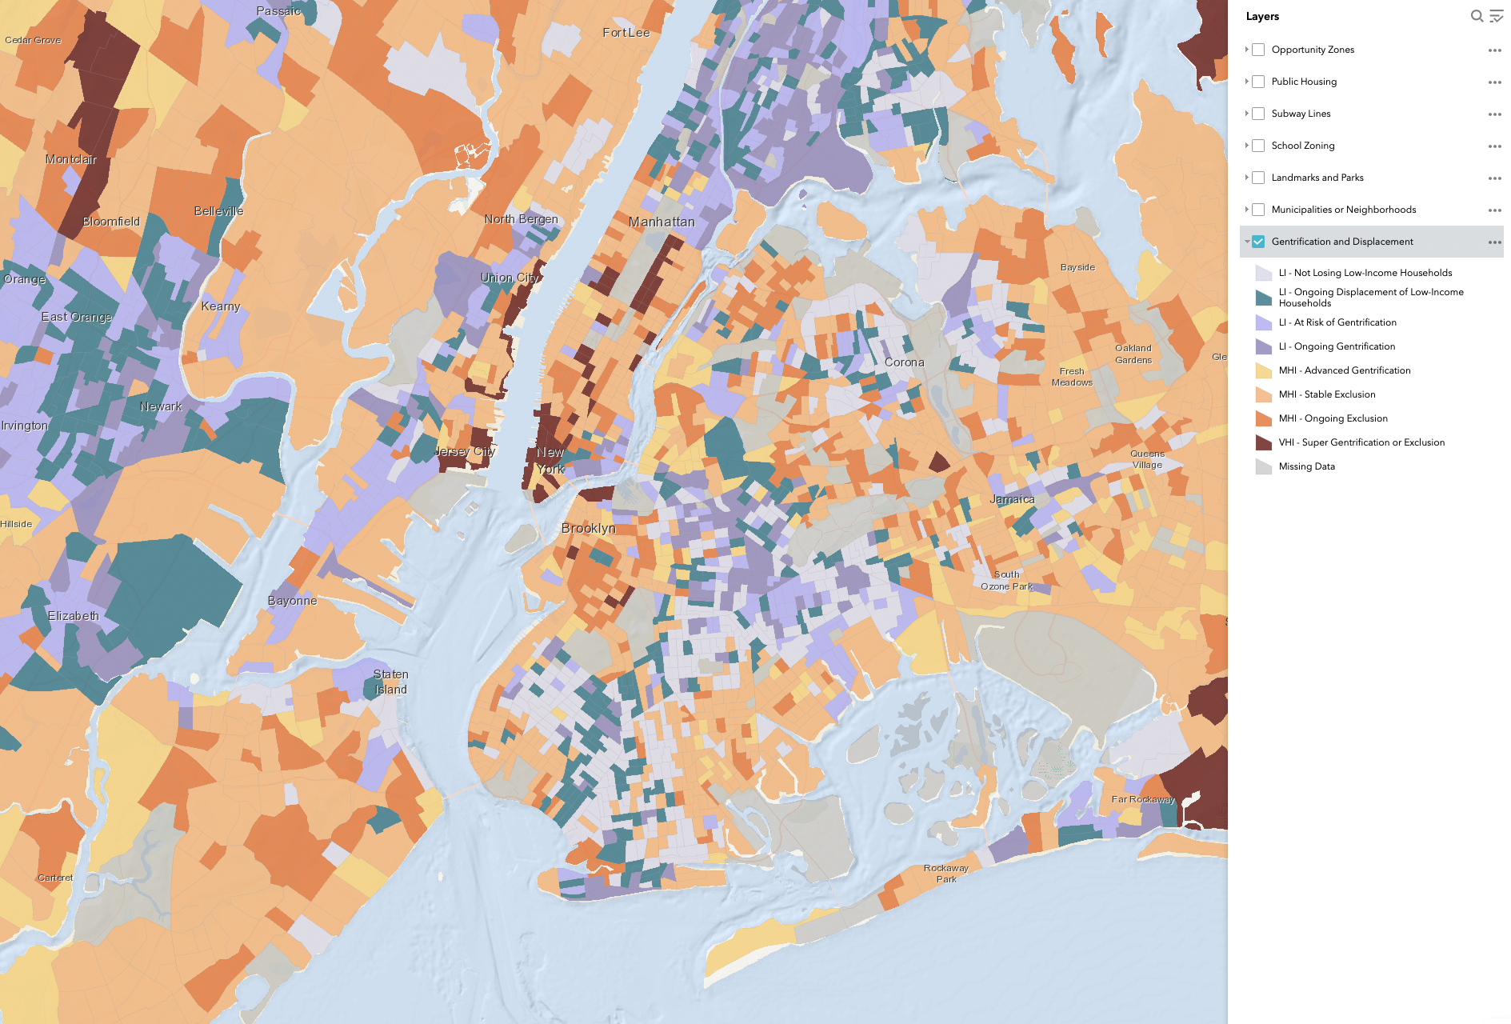

Slide 7
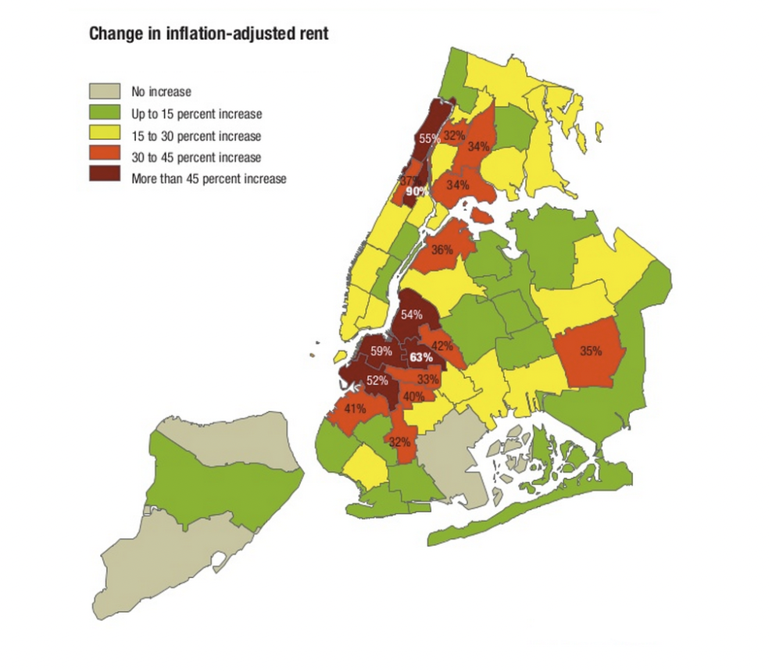
New York City
Gentrified areas of New York have seen dramatic increases in rent rates.
Areas that are considered to be ‘Stable’ and ‘Ongoing’ Exclusion zones have seen the least amount of increases.

Slide 8
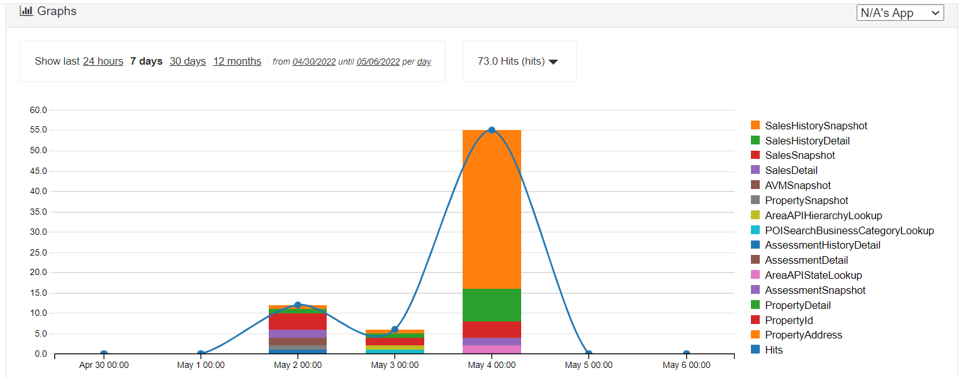
Notes:
During the course of the project, we relied on the Attom website for some information as well but unfortunately it was giving back several different errors. This site would have been very beneficial in providing us with information such as Sales History and details, Point of interest in regards to location, Assessment detail and their advance valuation model.

Slide 9
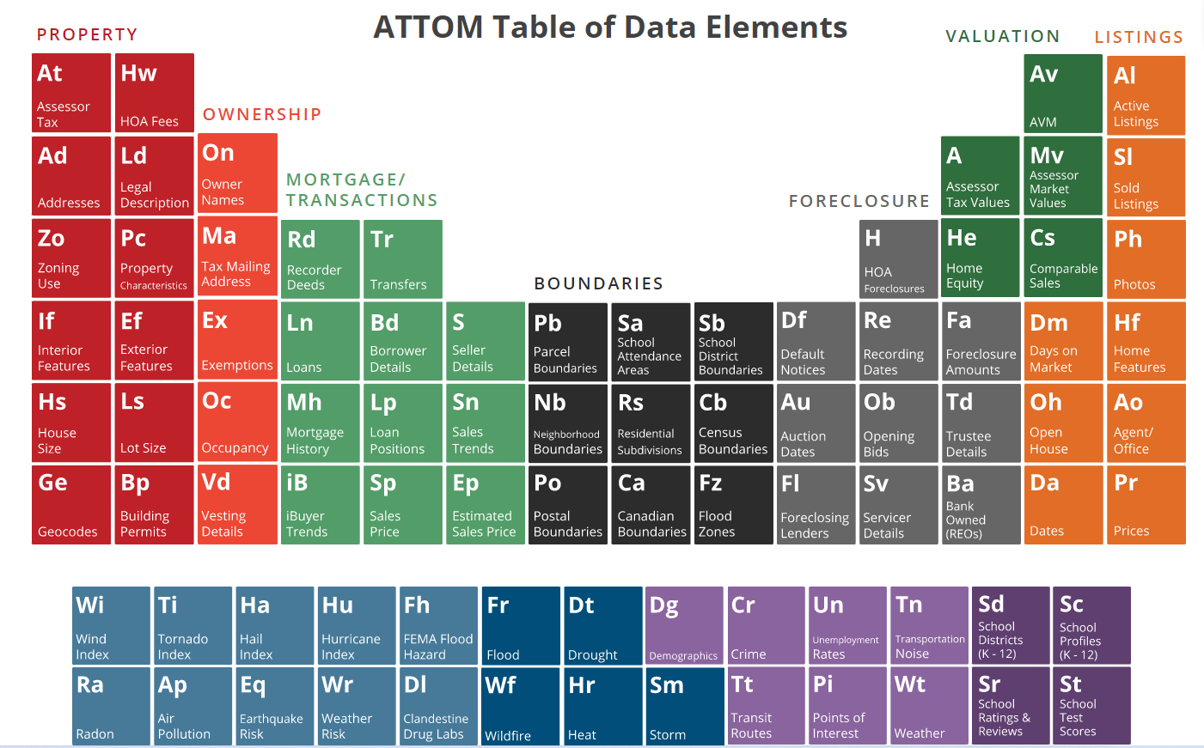
Notes:
With this data, the community will be armed with the same data that real estate invest companies use to gentrify cities. This gives the community a financial estimate as to what it would cost redevelop their community. The hope is to get a real pulse of each community. The more the communities are involved the more they get out of the redevelopment process. From a financial standpoint the community will reap the benefits of homes sold.

Slide 10
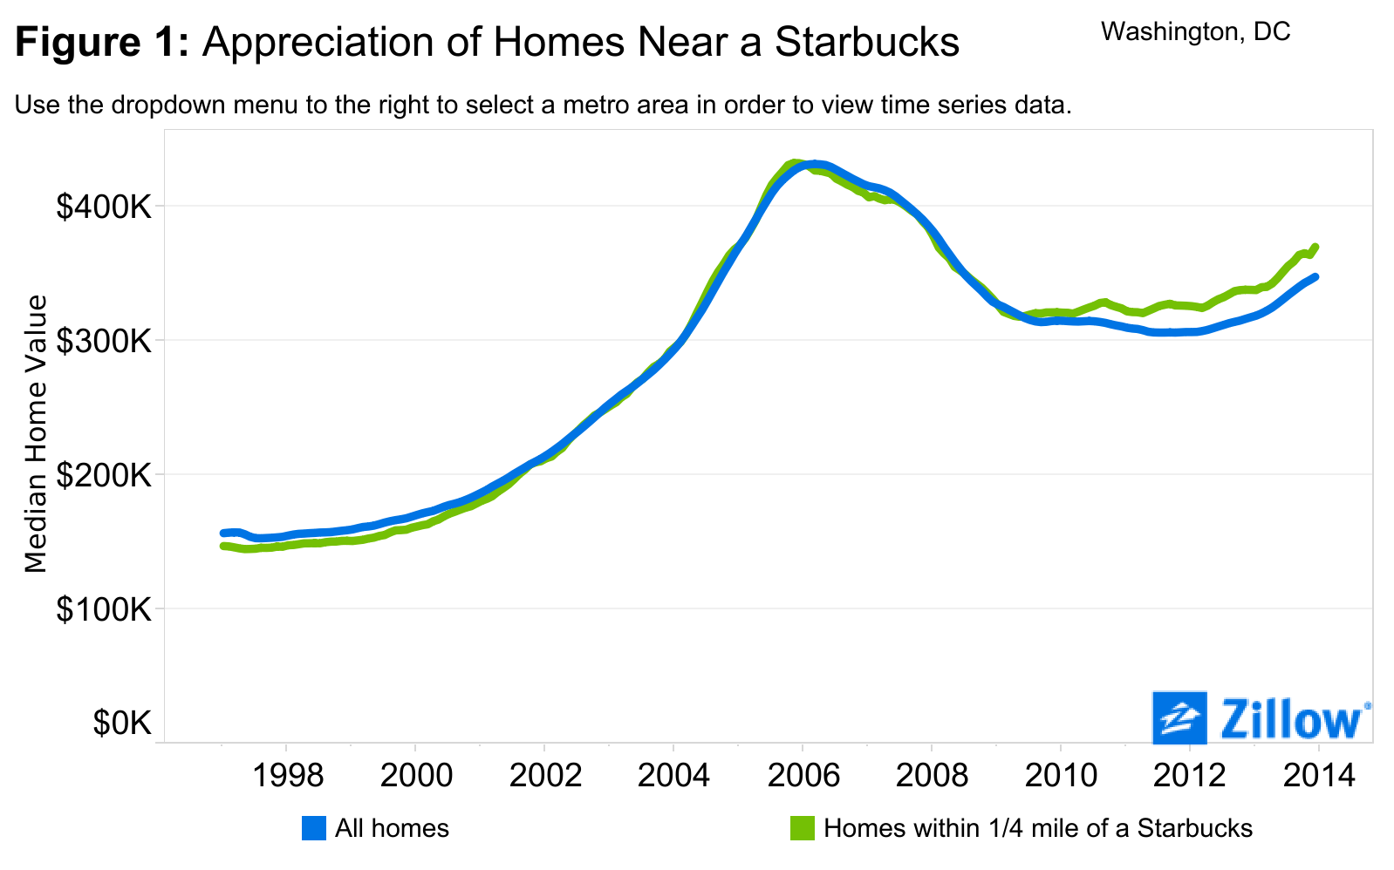
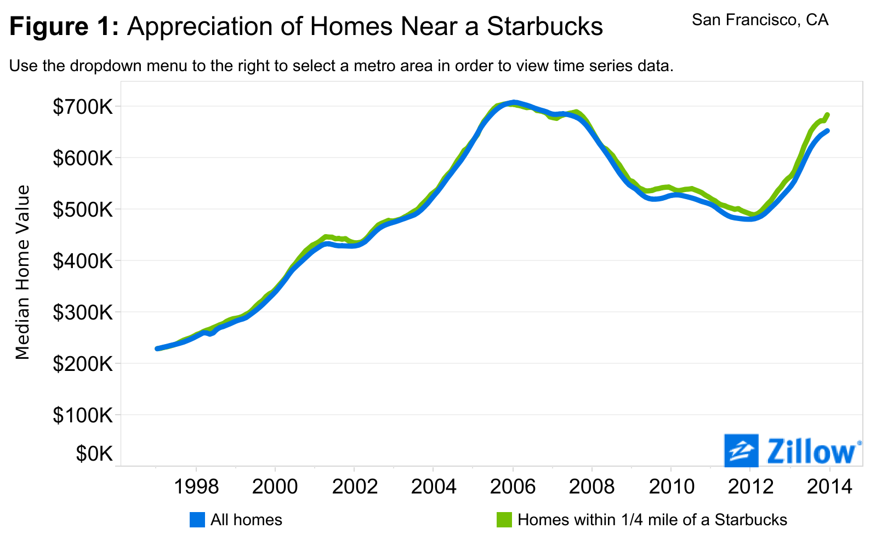
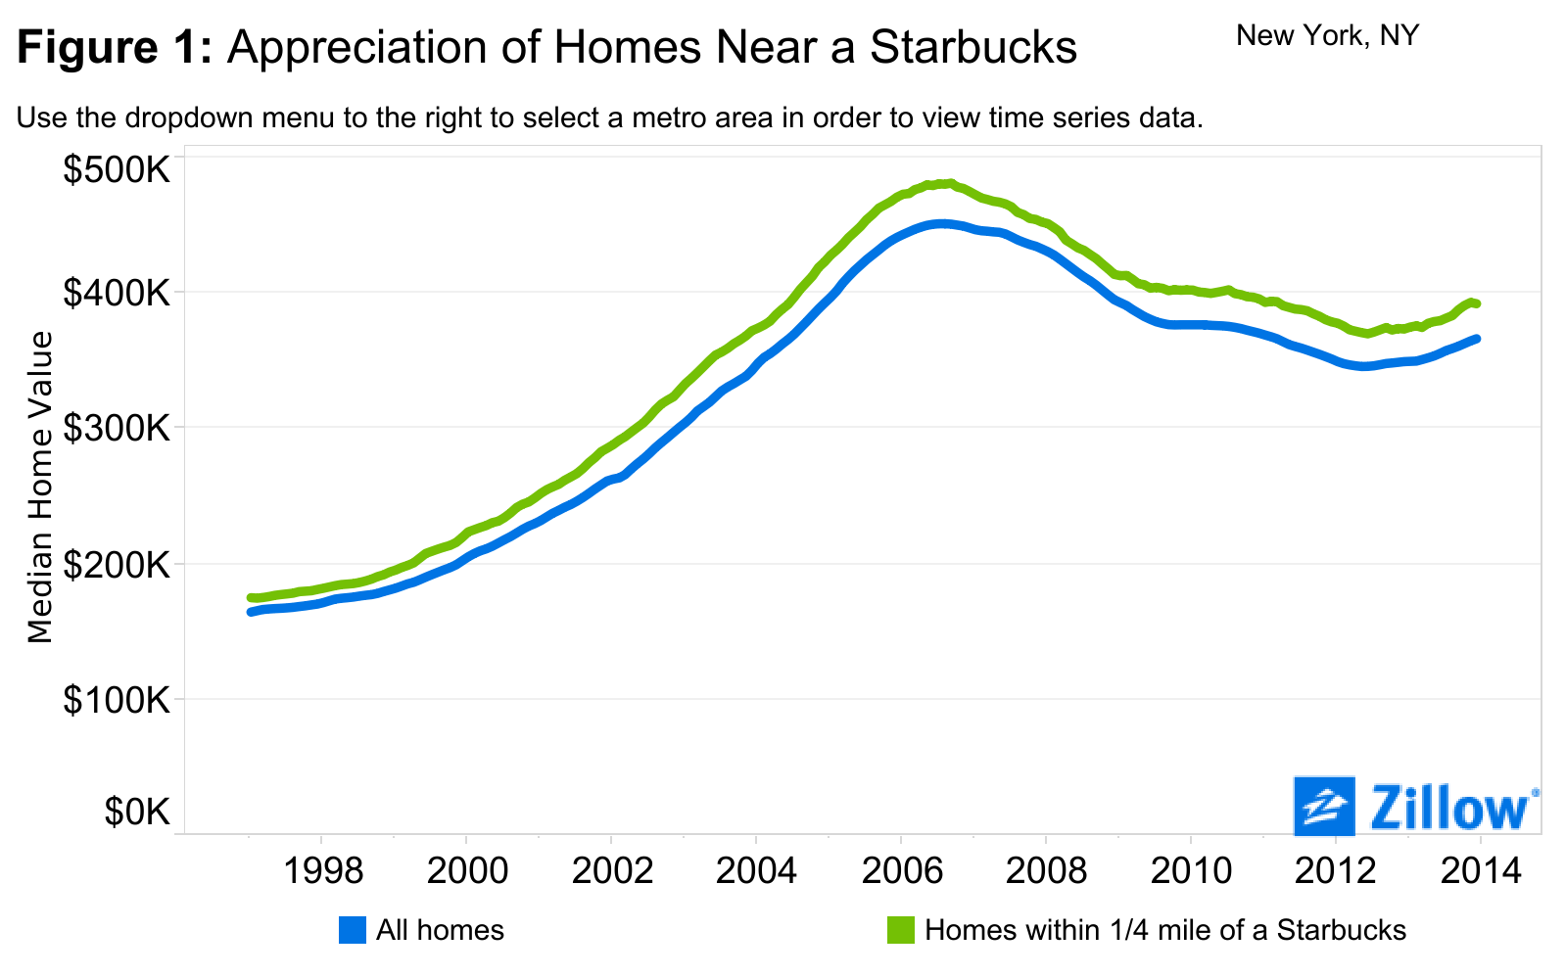
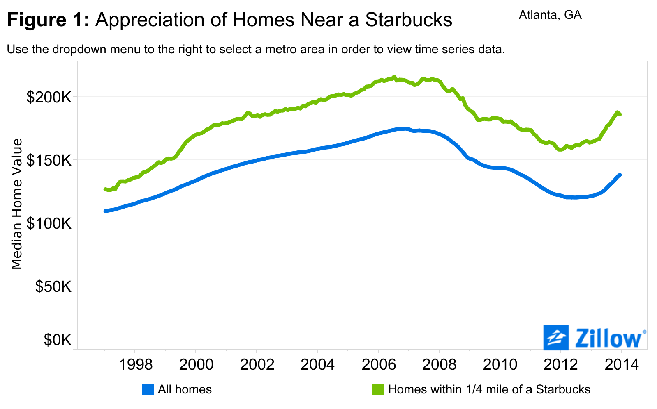
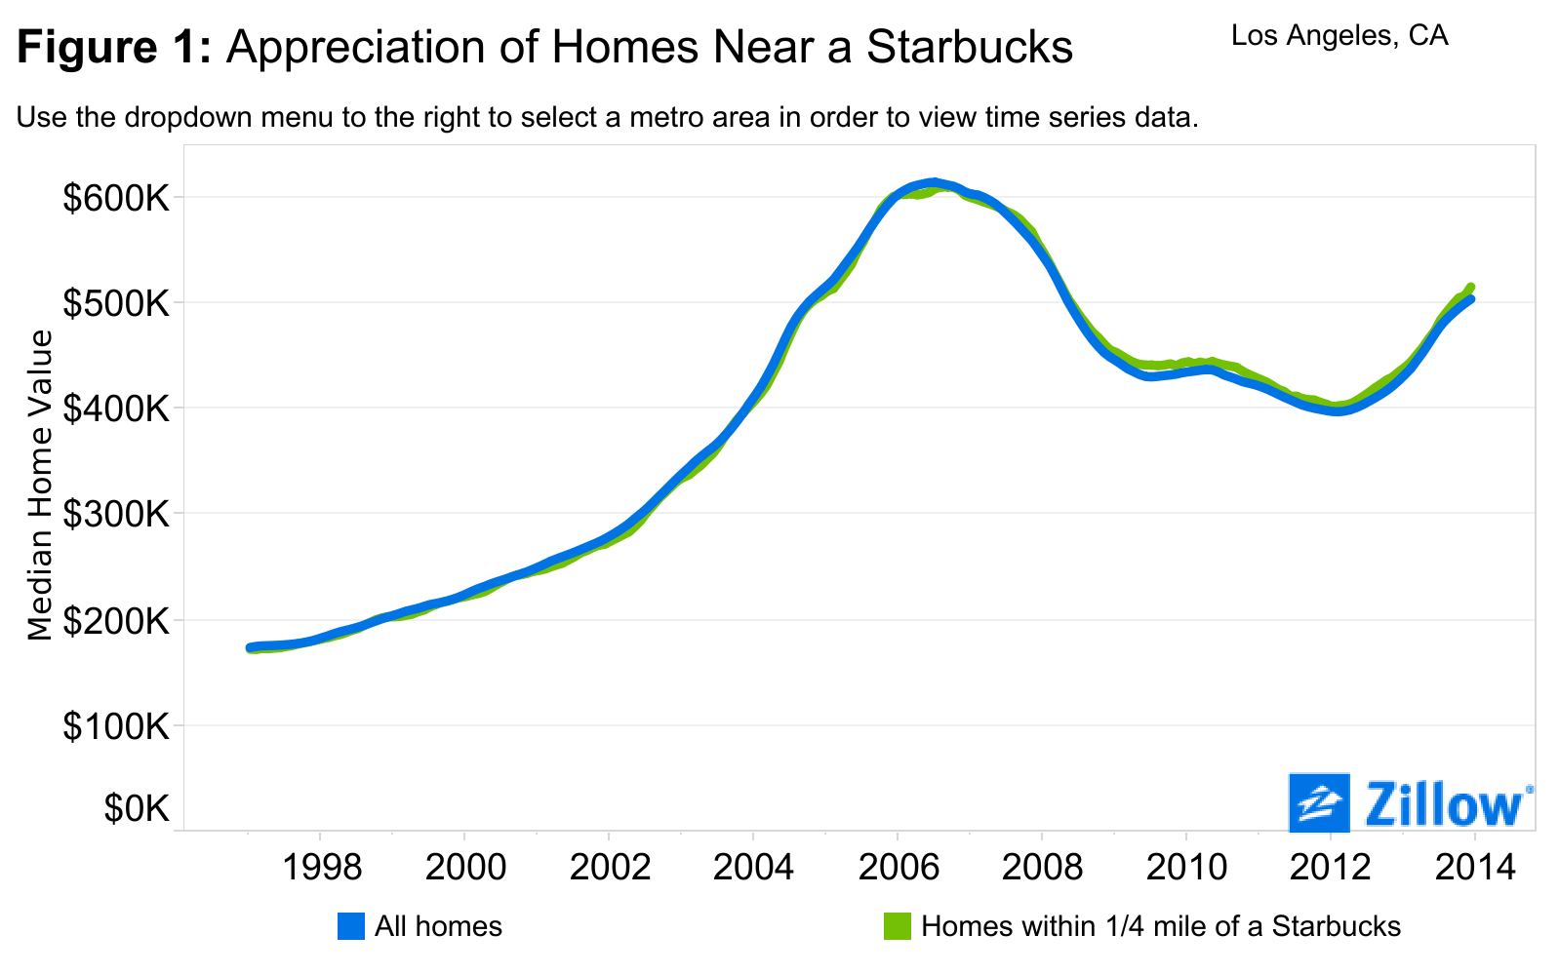
Starbucks: Inspiring and Nurturing the Human Spirit… by Caffeinating Home Values
Notes:
The graph above reflects how a home near a Starbucks has generally appreciated more than all homes.
Some other signs your neighborhood is gentrifying are:
Increase in Uber or Lyft drivers.
Starbucks, coffee shops or specialty shops
Art galleries.
Expensive vehicles
So how would we do this?
We would create a DAO (decentralized Autonomous Organization) with a token sale based on the valuation data gained. The community will use this data to pick opportunity zones. The voting system that will be set up to these communities to hold a larger voting power than those just financially invested. We hope to build a future where the voting system can cover items such as which which opportunity zones to invest in, if the community prefers swim clubs or parks. Basketball courts over tennis court and create a community that truly reflect the people that live there.
Anderson, Jamie. “Starbucks Home Value Appreciation.” Https://Www.Zillow.Com/Research/Starbucks-Home-Value-Appreciation-8912/?Msclkid=3b24ad5ac71411ecae7313de6eee7aa5, 13 Feb. 2015.

Slide 11
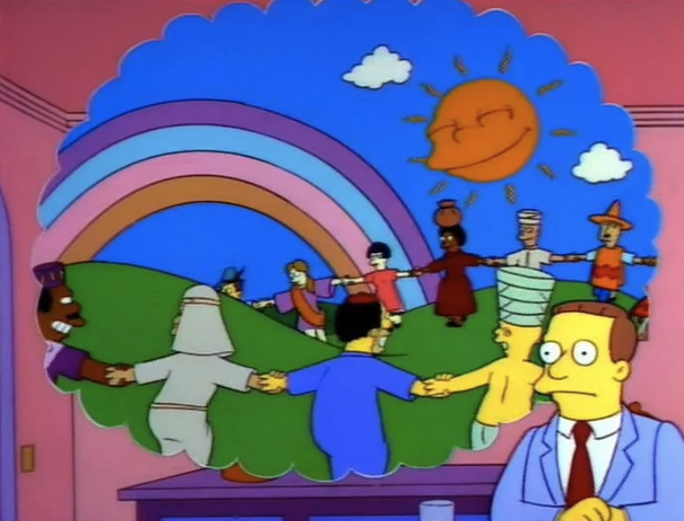
A world without
Gentrification!
*Disclaimer - We understand that there are many circumstances that can lead to displacement or homelessness other than gentrification.
Notes:
So how would we do this?
We would create a DAO (decentralized Autonomous Organization) with a token sale based on the valuation data gained. The community will use this data to pick opportunity zones. The voting system that will be set up to these communities to hold a larger voting power than those just financially invested. We hope to build a future where the voting system can cover items such as which which opportunity zones to invest in, if the community prefers swim clubs or parks. Basketball courts over tennis court and create a community that truly reflect the people that live there.

